Slide 1

Code Smell: Primitive Obsession
ERIK JONSSON SCHOOL OF ENGINEERING AND COMPUTER SCIENCE
The University of Texas at Dallas
Presenter: Team 13
Aditya Krishna, Shalin Ronakkumar Kaji, Gaurav Sharma
20 March 2024

Slide 2























































Taxonomy of Code Smells
Code smells
Bloaters
OO abusers
Change preventers
Dispensables
Couplers
Long method/class
Switch statements
Shotgun surgery
Duplicated /dead code
Feature envy
Data clumps
Temporary field
Divergent change
Speculative generality
Message chains
Long parameter list
Refused Bequest
Parallel Inheritance Hierarchies
Lazy class
Middle man
Primitive obsession
Alternative Classes with different Interfaces
Inappropriate Intimacy
Data Class
[1] Mäntylä, M. V. and Lassenius, C., "Subjective Evaluation of Software Evolvability Using Code Smells: An Empirical Study". Journal of Empirical Soft. Engineering, vol. 11, no. 3, 2006, pp. 395-431

Slide 3
Which category does it fall under?
Primitive Obsession falls under the "Bloater" category in the Code Smell Taxonomy.
Bloater smells refer to code that has grown so large and complex that it becomes difficult to understand, maintain, and extend.
Primitive Obsession contributes to bloated code by adding unnecessary complexity and reducing readability due to the proliferation of primitive data types and their associated logic.

Slide 4
What is Primitive Obsession?
Primitive obsession is a code smell in which primitive data types are used excessively to represent your data models. The problem with primitives is they are very general, and when they are used to hold domain concepts and ideas they result in inefficient programming. Domain concepts are the ideas that are unique to the setting of your application.
Primitive Obsession happens when we take the easy route. We start with simple fields to hold data because it's quick. But then we keep adding more fields this way, and soon our class becomes big and hard to manage.

Slide 5
How it violates Liskov’s Substitution Principle?
Liskov's Substitution Principle (LSP) states that objects of a superclass should be replaceable with objects of a subclass without affecting the correctness of the program.
In the context of Primitive Obsession, violating LSP can occur when primitive data types are used inconsistently throughout the codebase. For example, if different parts of the code expect different types of primitive data (e.g., int in one place, string in another), it becomes challenging to substitute one type for another without risking errors or unexpected behavior.

Slide 6
How to make it obey LSP?
Replacing primitive types with custom classes or objects enhances adherence to Liskov's Substitution Principle (LSP) by encapsulating behavior, ensuring consistent interfaces, and promoting polymorphic behavior. Custom classes encapsulate behavior related to data, ensuring that any changes or substitutions can be made without compromising program correctness. Additionally, consistent interfaces defined within these classes facilitate the interchangeability of subclasses, promoting code reuse and simplifying maintenance efforts. Ultimately, this approach fosters greater flexibility in substituting objects while maintaining program correctness, mitigating the risks associated with Primitive Obsession code smells.

Slide 7
Refactoring – 1: Introduce Parameter Object
This refactoring aligns with the principles of encapsulation and abstraction, and it draws upon design patterns such as the Builder or Factory patterns to create parameter objects that encapsulate related data.
To implement this refactoring, we first identify areas of code where primitive data types are excessively used to represent related pieces of information.

Slide 8
Refactoring – 1: Introduce Parameter Object
Instead of passing individual primitive parameters to methods or constructors, we consolidate these parameters into a single parameter object. This parameter object acts as a container for the related data, providing a more cohesive and meaningful representation of the concept.
Which design principle does it let us adhere to?
By introducing parameter objects, we adhere to the Single Responsibility Principle (SRP), as each parameter object is responsible for encapsulating a specific set of related data. This promotes code clarity and maintainability by reducing the proliferation of primitive data types and improving the readability of method signatures.

Slide 9
Refactoring – 1: Introduce Parameter Object
Furthermore, this refactoring technique enables us to apply design patterns such as the Builder or Factory patterns to construct parameter objects with complex initialization logic or validation requirements.
Introducing Parameter Objects can help reduce coupling by decoupling data representation from business logic. Exhibits Content Coupling.
Parameter Objects typically promote high cohesion within modules by encapsulating related data and behavior into a single class. Exhibits Functional Cohesion
Now let’s see this Code Smell and its refactoring using approach 1 using some real-world code examples.

Slide 10
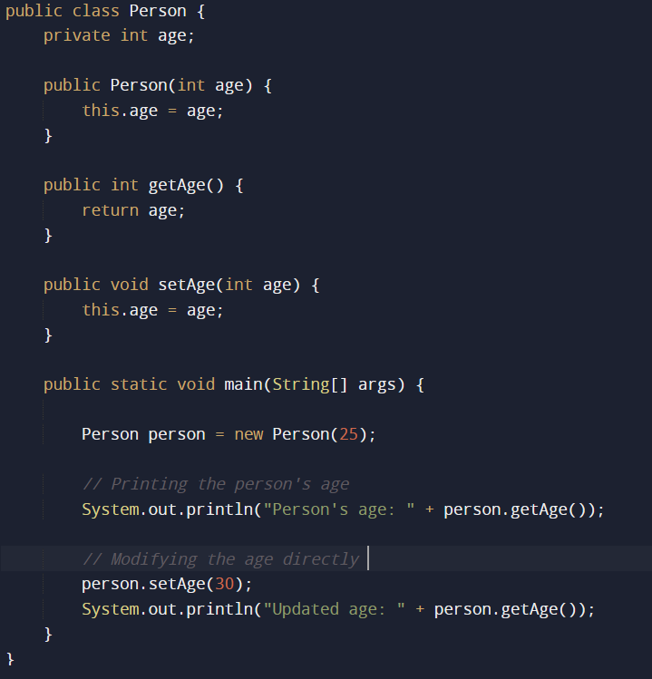
Can you identify the Primitive Obsession code smell in this class?
If so, how might it prove to be a bad design? any examples to support your answer!

Slide 11
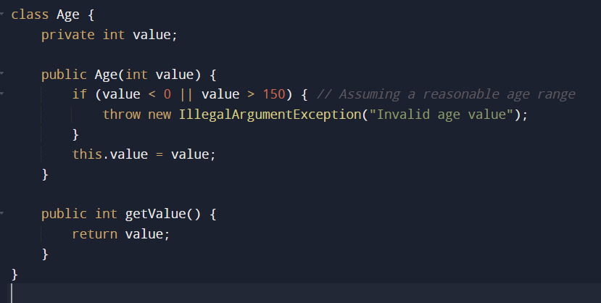
We cannot give User the liberty to set any age right?! I mean I would like to be immortal.

Slide 12
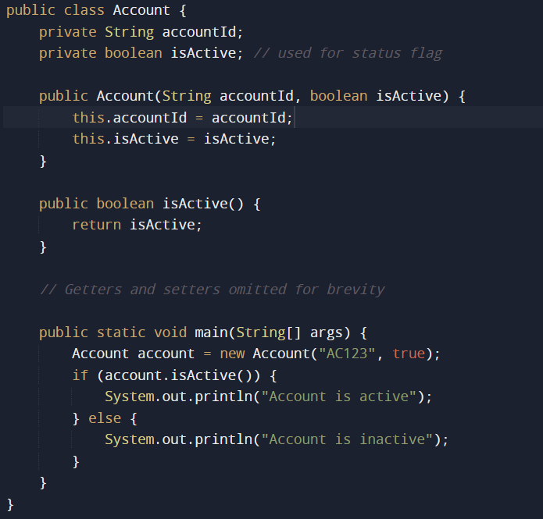
Let’s see yet another case of Primitive Obsession.
Too many flags?!

Slide 13
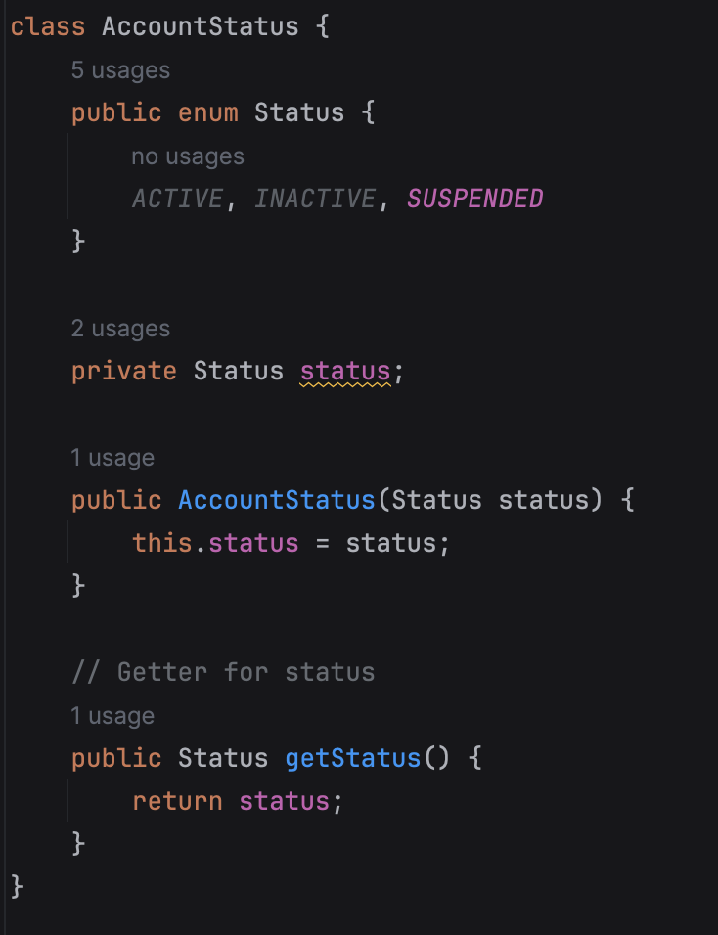
Here we have introduced the class AccountStatus and in that “Enum” is there to add the functionality for suspended account

Slide 14
Introduce Parameter Object – Merits :
Improved Maintainability: By consolidating related parameters into a single parameter object, the code becomes more modular and easier to maintain. This makes it simpler to understand and modify the code as requirements change over time.
Enhanced Extensibility: Parameter objects provide a flexible and extensible way to represent complex data structures. As the software evolves and new features are added, the parameter object can be easily extended to accommodate additional data fields or behavior without significantly impacting existing code.
Avoid Code Duplication :- By creating the parameter object we can use it at other places also and avoid code duplication.

Slide 15
Introduce Parameter Object – Disadvantages :
Increased Complexity Initially: Introducing parameter objects may initially increase the complexity of the codebase, especially if the parameter objects themselves require complex initialization logic or validation rules.
Potential Performance Overhead: Depending on the implementation, using parameter objects may introduce a slight performance overhead compared to passing primitive parameters directly. This is because accessing data within a parameter object may involve additional method calls or indirection, which can impact performance, especially in performance-critical applications.
Debugging and Troubleshooting :- Debugging the code that involves Parameter objects maybe slightly more complex.

Slide 16
Refactoring Technique 2
Replace Type Code with Class

Slide 17
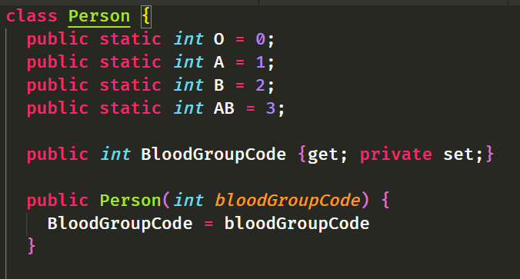
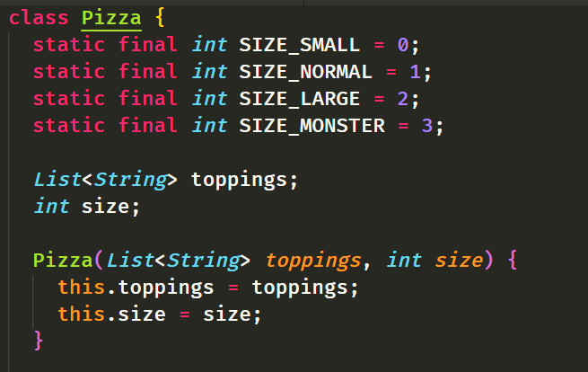
Refactoring Technique 2: Replace Type Code with Class
Understanding Type Code

Slide 18
Refactoring Technique 2: Replace Type Code with Class
Cons of Type Code:
Lack of Meaningful Semantics
Violation of Encapsulation
Limited Extensibility
Difficulty in Maintenance
Lack of Type Safety

Slide 19
Refactoring Technique 2: Replace Type Code with Class
How to tackle this code smell? --- code walkthrough
Create a new class and give it a new name that corresponds to the purpose of the coded type. Here we’ll call it type class.
Copy the field containing type code to the type class and make it private. Then create a getter for the field. A value will be set for this field only from the constructor.
For each value of the coded type, create a static method in type class. It’ll be creating a new type class object corresponding to this value of the coded type.
In the original class, replace the type of the coded field with type class. Create a new object of this type in the constructor as well as in the field setter. Change the field getter so that it calls the type class getter.
Replace any mentions of values of the coded type with calls of the relevant type class static methods.
Remove the coded type constants from the original class.

Slide 20
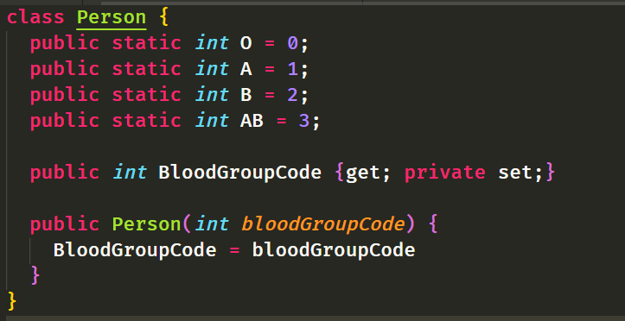
Refactoring Technique 2: Replace Type Code with Class

Slide 21
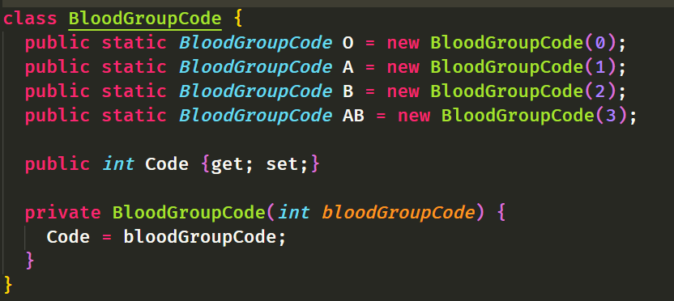
Refactoring Technique 2: Replace Type Code with Class
Create a Separate Class

Slide 22
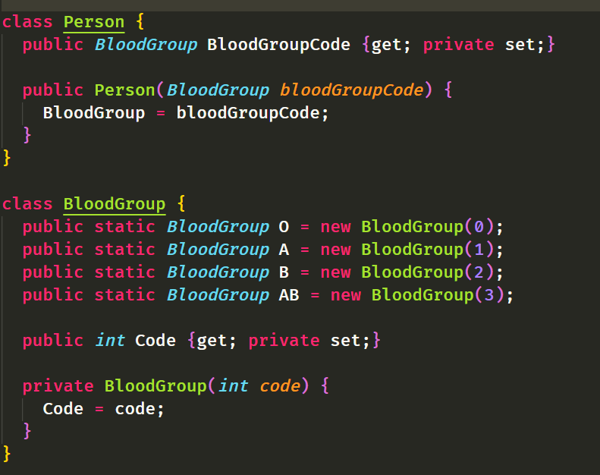

Refactoring Technique 2: Replace Type Code with Class

Slide 23
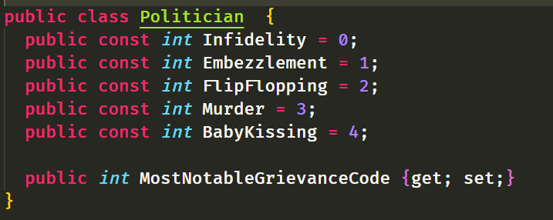
Refactoring Technique 2: Replace Type Code with Class

Slide 24
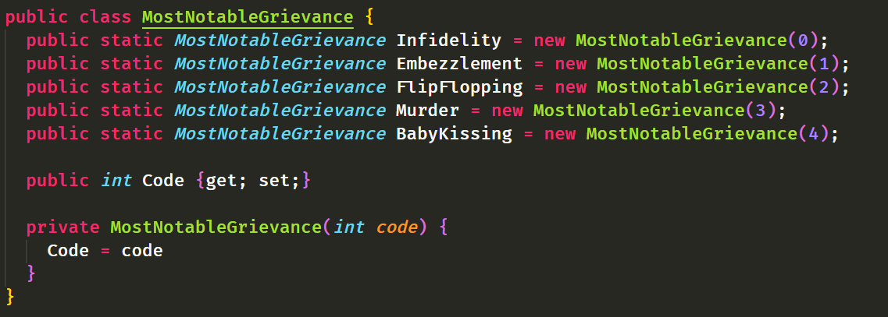
Refactoring Technique 2: Replace Type Code with Class

Slide 25
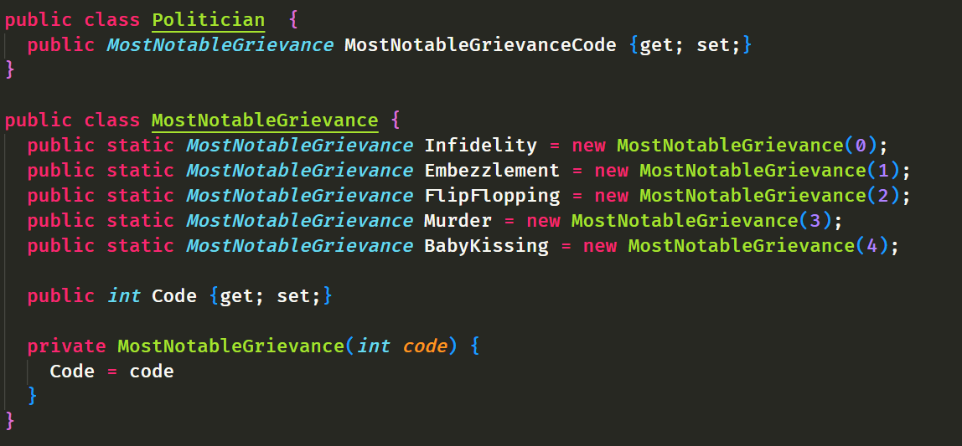
Refactoring Technique 2: Replace Type Code with Class

Slide 26
Refactoring Technique 2: Replace Type Code with Class
Pros of Replacing Type Code with Type Class:
Turn sets of primitive values into full-fledged classes
Move Code to the Classes of the type
Allows type hinting for values

Slide 27
Refactoring Technique 2: Replace Type Code with Class
References:
https://www.baeldung.com/java-liskov-substitution-principle
https://refactoring.guru/introduce-parameter-object
https://rockit.zone/post/switch-case/replacing-type-code-with-class/
Refactoring Book – Martin Fowler

Slide 28
Refactoring Technique 2: Replace Type Code with Class
Thank You!

